Slide 1

POLY ALUMNI NETWORK (PAN)
From Friendship To National Impact
1st Anniversary, May 21, 2022
Maryland, USA

Slide 2
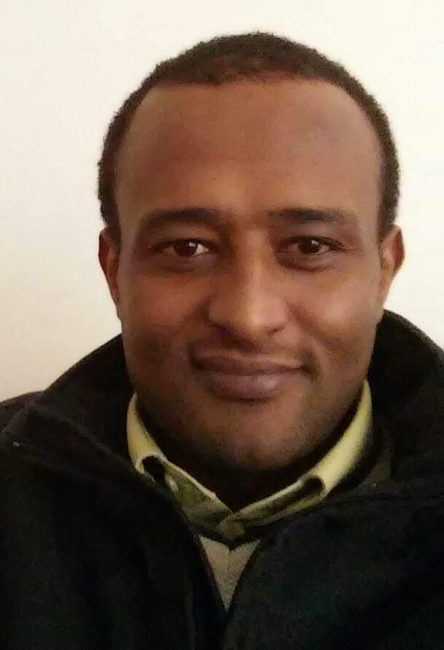
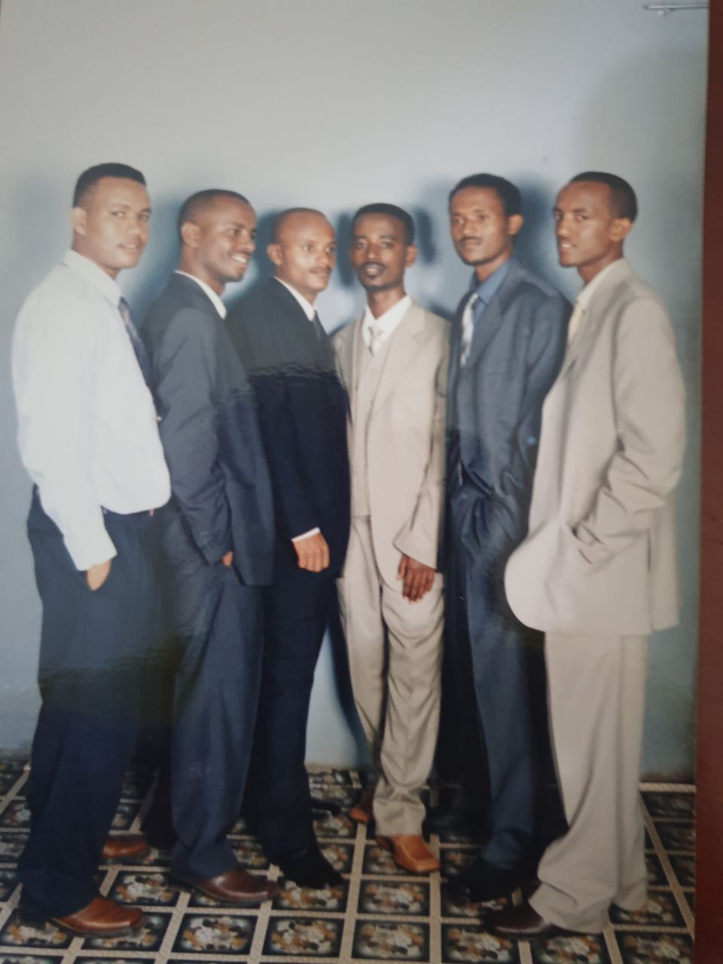
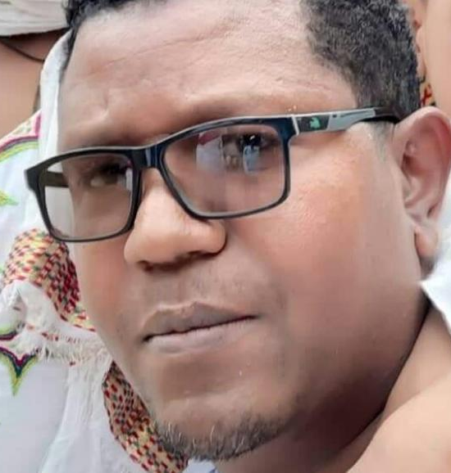
How it all started
The idea was initiated during the death of our beloved brother Tesfahun.
Poly Alumni Network (PAN) is an association established by the former and current students of Bahir Dar Institute of Technology
PAN always remember Engineer Tesfahun , Tagel, Ephrem and Kefyalew as a founding member of PAN.

Slide 3

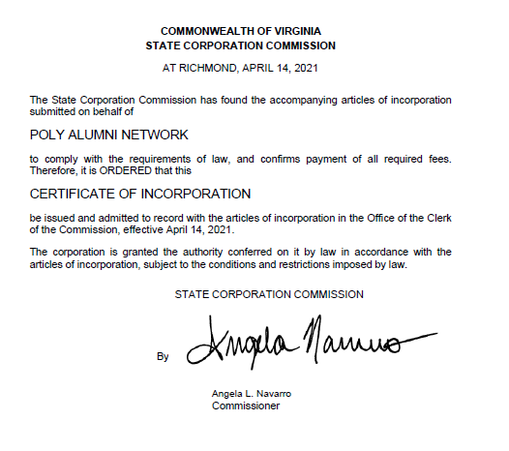
Registered in USA as Non-Profit

Slide 4
Mission and
Vision
The vision of PAN is to create a united and strong alumni association that will bring continuous positive impact to Ethiopian institutions and communities
The mission of PAN is to engage all alumni and affiliates across the globe to remain connected and share experience among members and contribute to the development of members, Ethiopian society and institutions through projects, professional service, research collaboration, education, mentorship, fund raising and trainings.

Slide 5
Objectives
Foster a strong relationship and cooperation among members
Provide technical support and information to alumni
Support community and projects through professional , volunteer and possible financial aids
Provide knowledge and technology transfer through research, training and consultation.
Facilitate a collaboration among Ethiopian and other international institutions and professionals.
Provide possible financial support at the time of death of a member.
Facilitate fund raising activities when a member facing economic hardship.

Slide 6
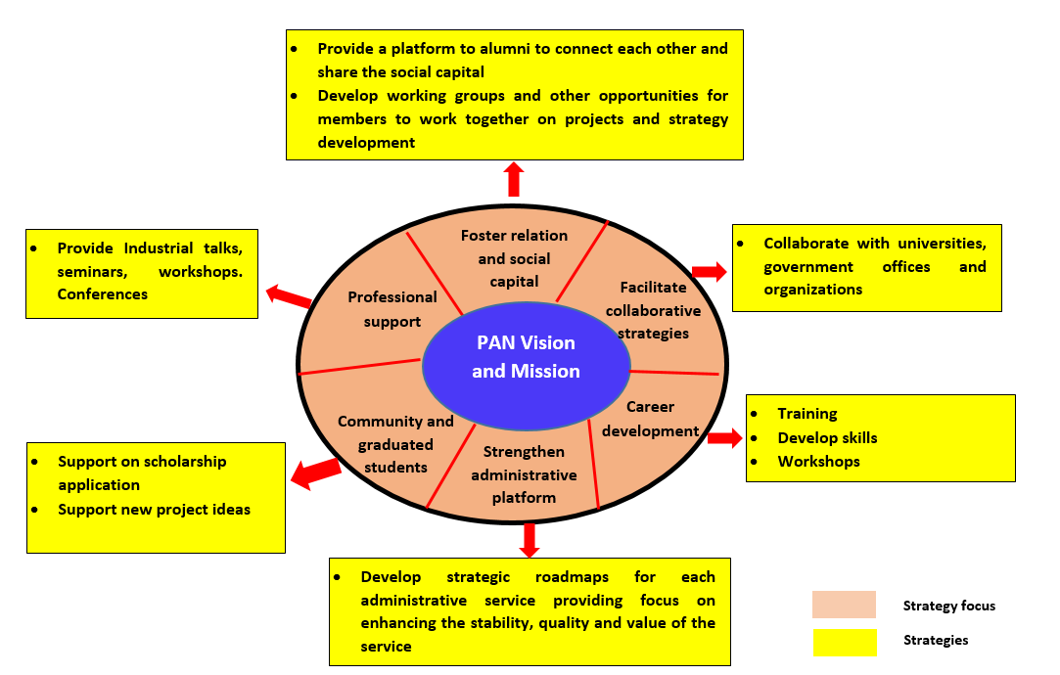
Strategic Framework

Slide 7
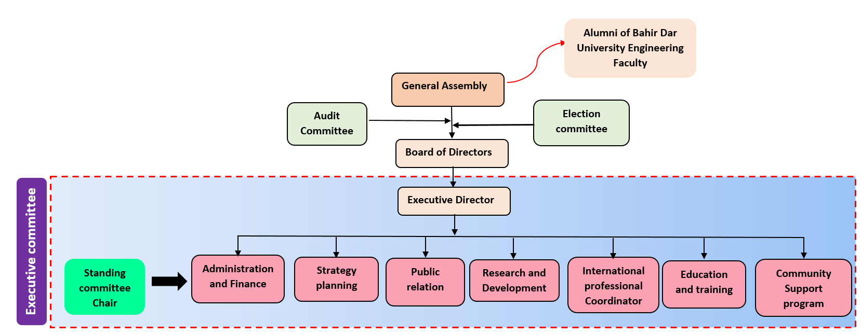
ORG Chart

Slide 8
Activities Past One Year
The PAN committee prepared Bylaw
Registered as a Non-profit organization in USA
The committee managed to recruit 503 unofficial members in telegram
Official Bank account opened in USA
PAN members heavily involved in financially supporting members during difficult times.
PAN members participated to organize fund raising program for Dina’s Transplant and also contributed significant amount of money

Slide 9

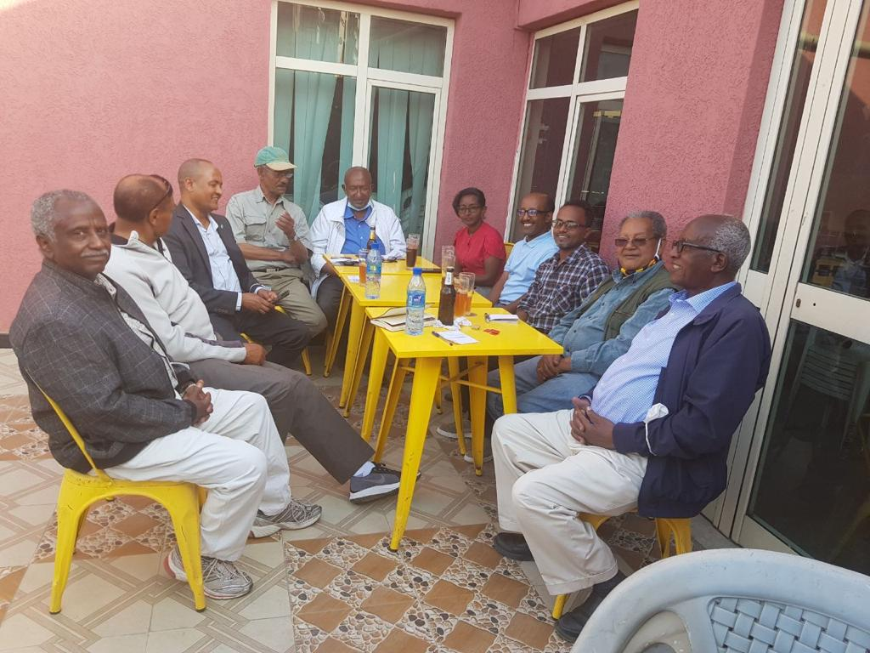
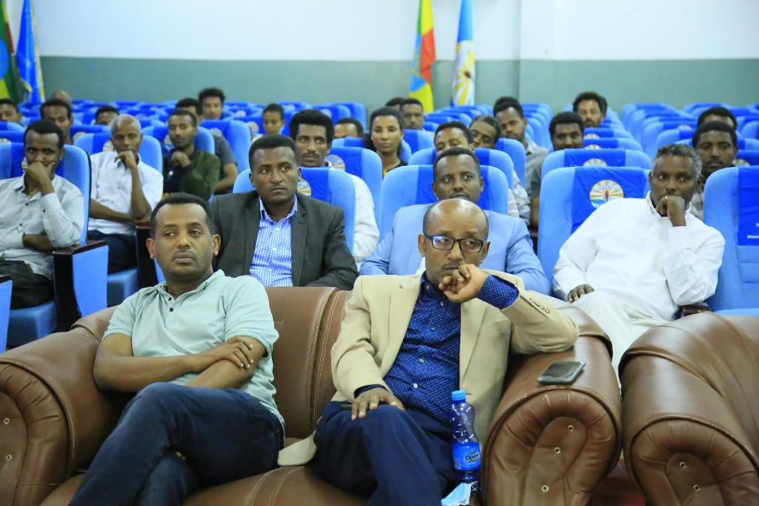
Activities Past One Year
Created connection with Bahir Dar University officials to work together.
Started communication with former Polytechnic graduates
PAN’s Secretary, Dr. Melak held a workshop at Bahir Dar University

Slide 10
Challenges
PAN was not able to move as expected due to
COVID-19 pandemic restrictions
War in Northern parts of Ethiopia
Not enough volunteers actively engaging in membership recruitment

Slide 11
Short Term Plan
Register at least 1000 official members within 3 months and collect annual registration fee. This will strengthen financial capacity of the association
Form General Assembly
Invite people to join telegram group- Expected number is 3000 members for the coming 6 months
Participate in the 60th anniversary of Bahir Dar university. (Provide professional and financial support if possible )
Sign MOU with former polytechnic graduate and Bahir Dar university on what we can work on together.

Slide 12
Long Term Plan
Support community and commercial Projects
Support students on scholarships
Organize conferences and workshops
Provide professional support in teaching and research
Organize trainings for members and Ethiopian universities to develop their skills
Career development opportunities

Slide 13
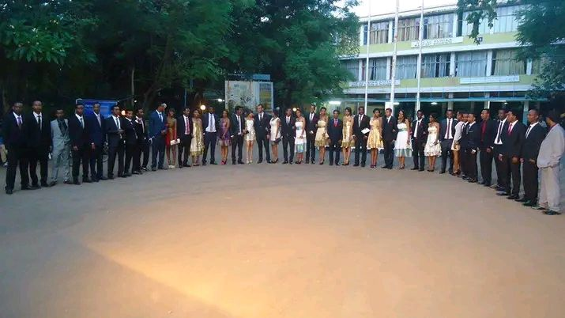
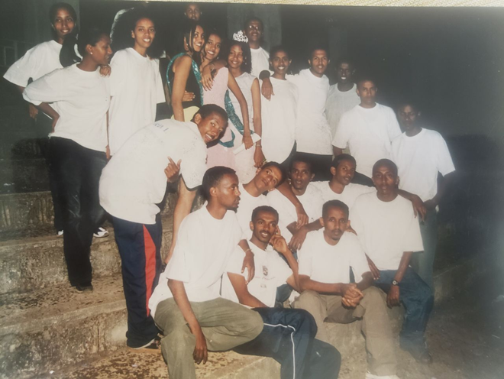
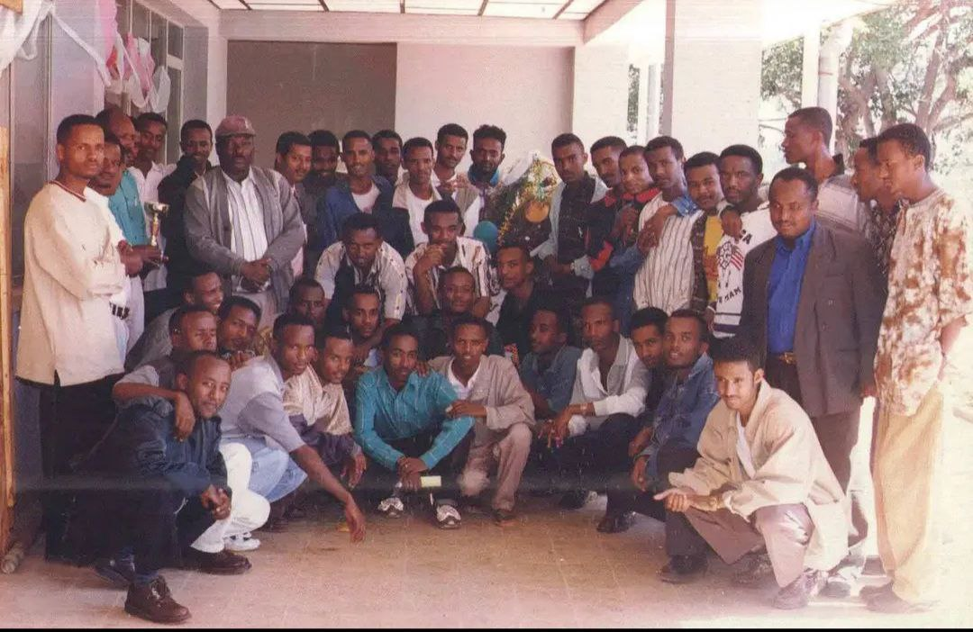
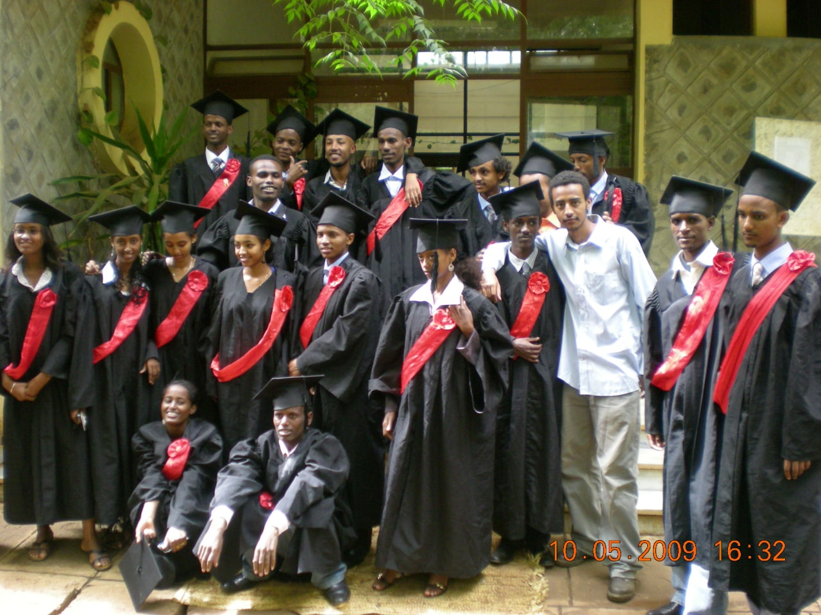
Class of
2001 E.C
1993 E.C
1994 E.C
2006 E.C

Slide 14
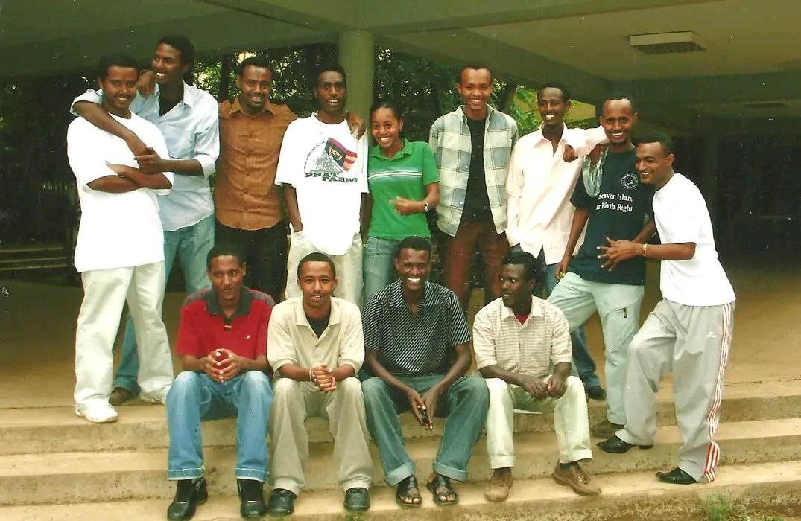
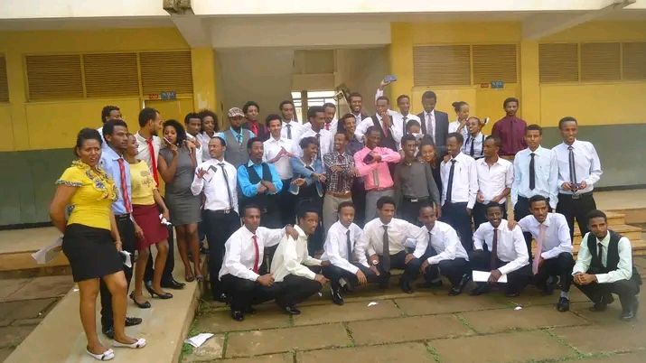
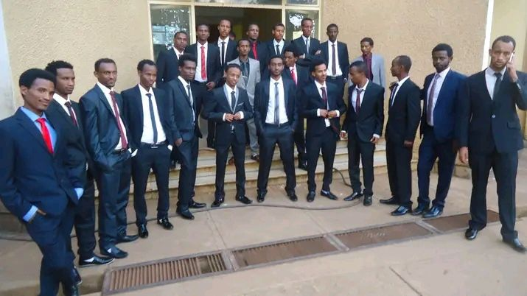
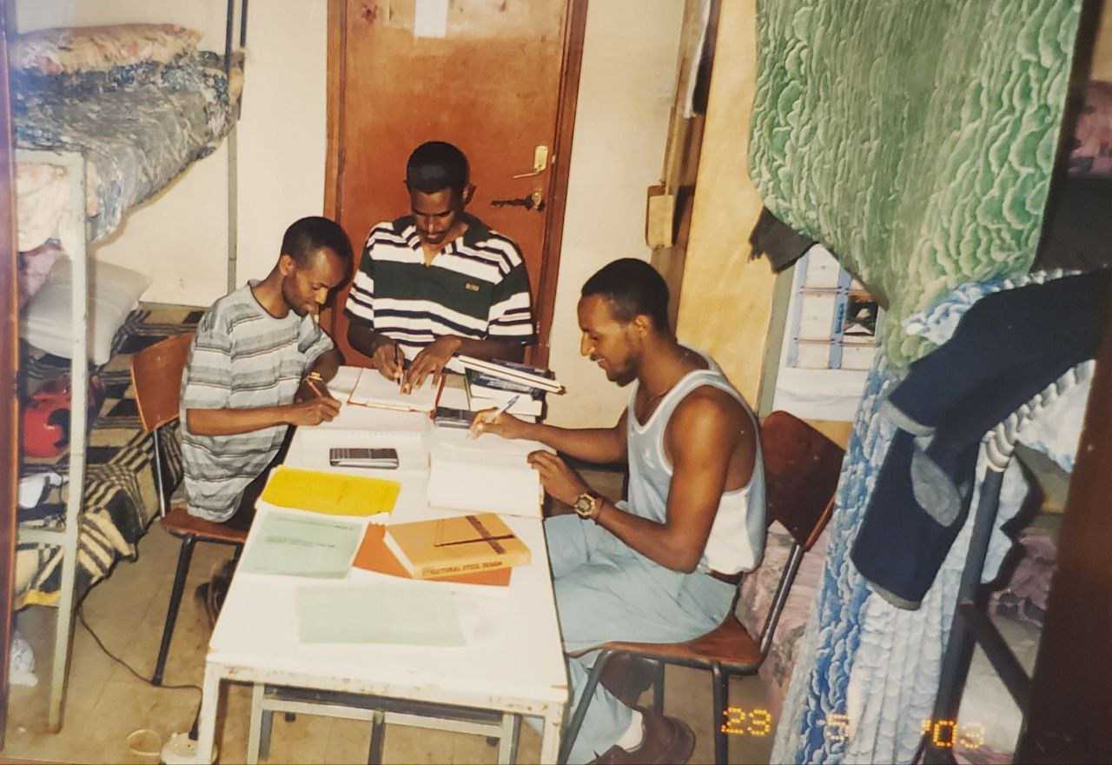
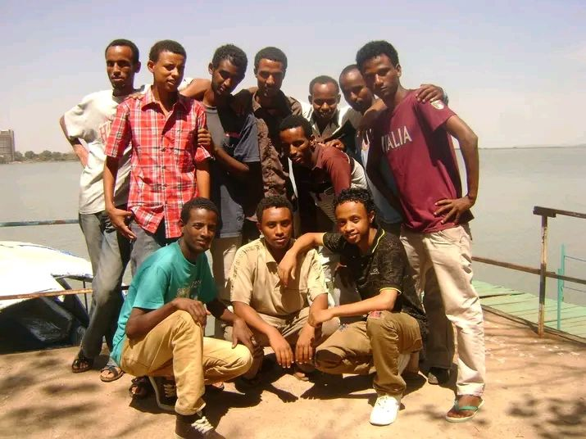
Class of
1995 E.C
1999 E.C

Slide 15
Conclusion
PAN is established to payback to the community
PAN does not have any affiliation with politics, race and religion.
Friendship, share and support are key principles of PAN

